Slide 1
Ultrasonic Rangefinder using 8051 Microcontroller
By
SUMAN KUMAR 4NM19EC181
SUMITH S KUMAR 4NM19EC182
SURAKSHA S BOLAR 4NM19EC183
SUHAS OMKAR 4NM19EC180

Slide 2
Objectives
1.The ultrasonic module HC-SR04 is interfaced to the AT89C51 (8051 microcontroller) through the ports and also used for transmitting the 8 bit display data to the 3 common anode 7 segment display.
2. To develop algorithm to calculate time delay between transmitting Ultrasonic waves and picking up its echoes.
3. To detect the presence and give the position of the object.
4. To develop algorithm to interface Three common anode 7 segment displays with AT89C51 to display the corresponding distance measured.

Slide 3
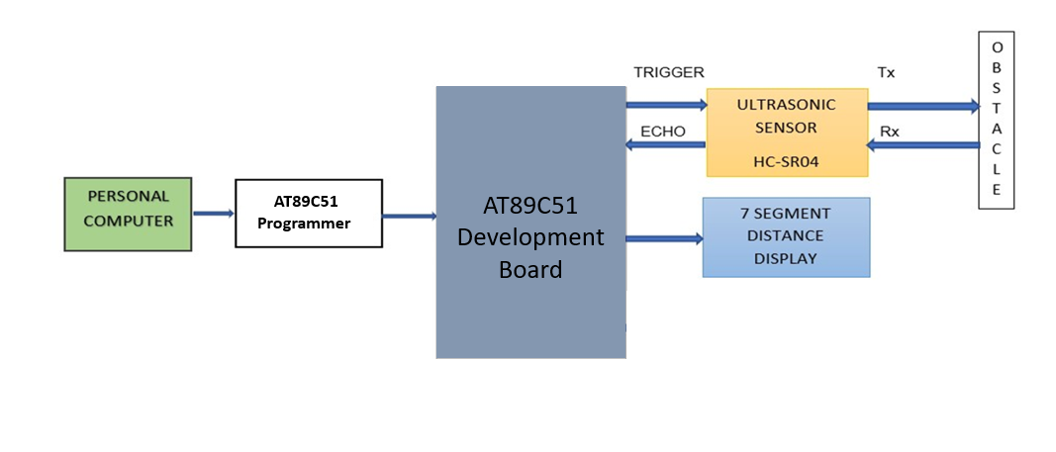
Block Diagram

Slide 4
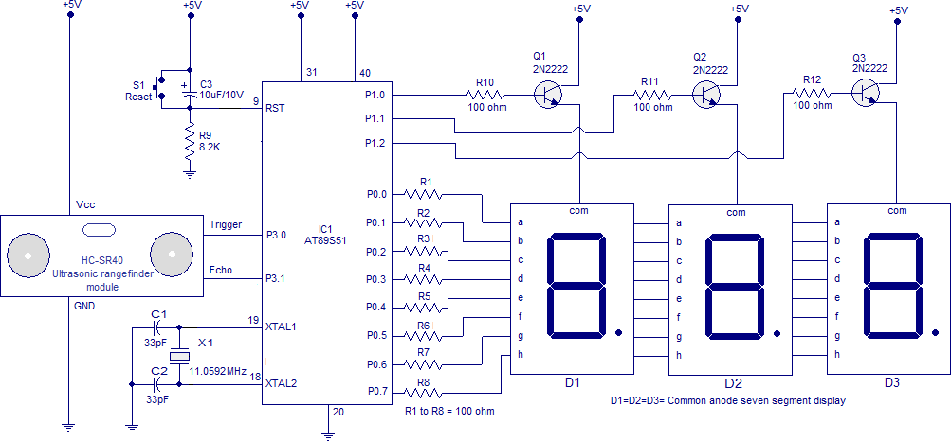
Circuit Diagram

Slide 5
Methodology
1. To interface HC-SR04 with AT89C51 micro controller
The sensor module has 4-pins out of which Pin-1 and Pin-4 are +Vcc and Gnd respectively.Pin-2 is Trigger and Pin-3 is Echo pin.
The TRIGGER and ECHO pins of the Ultrasonic Sensor are connected to the P3.0 and P3.1 pins respectively.
Power supply pins of the microcontroller, SSD and Ultrasonic Sensor are connected to the 5V DC.
Initially burn the program to the microcontroller and give the connections as per the circuit diagram.

Slide 6
Methodology
2. To develop algorithm to calculate time delay between transmitting Ultrasonic waves and picking up its echoes
When a High pulse of 10us is applied at TRIG pin, the ultrasonic transmitter sends 8 consecutive pulses of 40kHz frequency
Wait until the module transmits 40 KHz pulses. When 8th pulse is transmitted echo pin becomes HIGH TIMER1 starts counting
The time it takes to leave and return to the sensor is used to find the distance.
Here the timer starts counting from 207D because from datasheet we know that count 58 corresponds to one cm
So here we take count as 48 and this is done to in order to compensate for the time lags caused by the branching instructions used for checking the status of P3.0 and P3.1 Pins

Slide 8
Methodology
3. To detect the presence and give the position of the object
The speed of the ultrasonic pulse is nothing but the speed of sound which is 340.29 m/s or 34029 cm/s
When a High pulse of 10us is applied at TRIG pin, the ultrasonic transmitter sends 8 consecutive pulses of 40kHz frequency.
Eighth pulse is sent the ECHO pin of the sensor becomes HIGH
Now when the ultrasonic waves reflect from any surface and are received by the Receiver, the ECHO pin becomes LOW
The time it takes to leave and return to sensor is used to find the distance from the reflecting surface
Distance in centimetres = (Time/58) cms

Slide 9
Methodology
4. To develop algorithm to interface Three common anode 7 segment displays with AT89C51 to display the corresponding distance measured
The Data lines of Seven Segment Displays are interfaced at Port-0
Port-1’s, Pin-0,1 and 2 are select line for the SSDs.
In the main part of Program, firstly Timer-1 is initialized in mode2 (8-bit auto reload)
When P3.0 is set high, subroutine DELAY1 is called. After 10us P3.0 is reset to 0
Now P3.1 is checked for a high signal. As P3.1 becomes high, Timer 1 starts and every time it overflows Register A is incremented.

Slide 10
Continued..
The Count Value loaded is to be 58 (mentioned on the datasheet). So that after 58 cycles A gets incremented once. But since the delay caused due to instructions have to compensated, the count value used is 48 (=> 255D-207D).
The value stored in A is used to extract the Distance measured. This is done by Division instruction.
The 8-bit data value is sequentially sent to respective 7-Segment Display being selected through the selection lines.

Slide 11
List of the Components Required
Name | Description | unit price
AT89S52 | The Atmel AT89S52 is an 8051 based Full Static CMOS controller. | ₹130.00
Three 7-Segment Display (Common Anode type) | Consists of seven LEDs arranged in a rectangular fashion as shown | ₹40.00
HC-SR04 (Ultrasonic sensor module) | This economical sensor provides 2cm to 400cm of non-contact measurement functionality with a ranging accuracy that can reach up to 3mm. | ₹100.00
Consists of bult-in programmer and 11.0592 MHz crystal oscillator Used to make interconnection between components
8051 Development Board ₹1400.00
Connecting wires
₹50.00

Slide 12
THANK YOU

